Slide 1
J. Wunderlich PhD
B.S. Architectural Engineering (U. Texas)
Plus 2 years of Urban Design (U. California, San Diego)
Architectural Theory
All photographs by J. Wunderlich unless noted otherwise

Slide 2
Agenda
Architectural vocabulary
Some personal designs

Slide 3
Architectural Vocabulary
Form
Scale
Behavior
Context
Proportion
Balance
Symbolism
Tastes
Anthropomorphism
Color
Texture
Rhythm

Slide 4
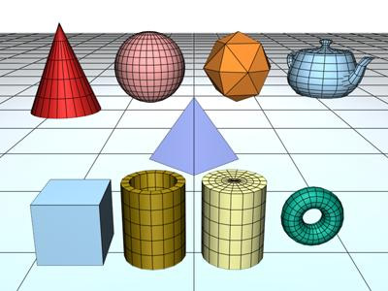
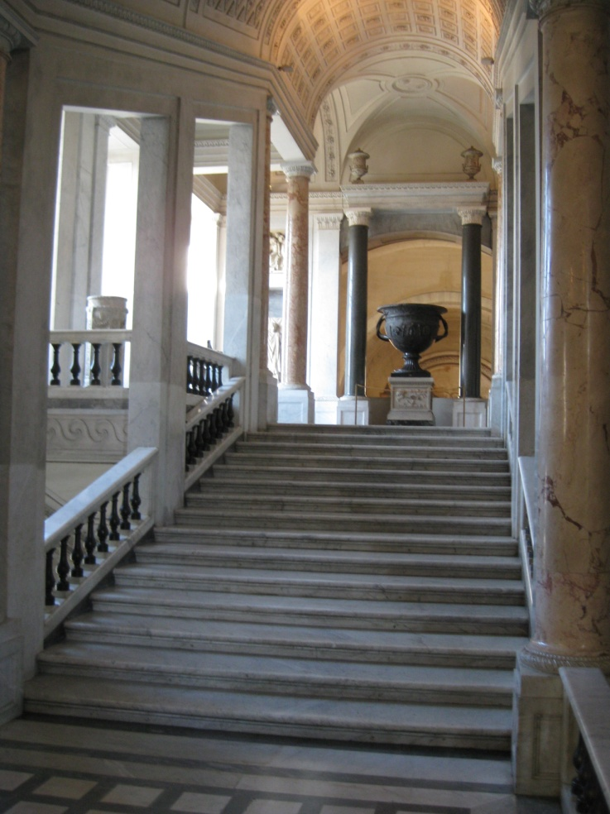
Form
Recently in the U.S. and many developing countries we accept geometric shapes with sharp edges
In the past, Euclidian (columns, domes) were more accepted
Louis Sullivan, and later Frank Lloyd Wright and various Modern Architects would say,
      “Form follows function.”
However Frank Lloyd Wright said:
  “ Form follows function - that has been misunderstood. Form and function should be one, joined in a spiritual union.”
  We will discuss later Frank Lloyd Wright’s inspirations from Japan, and the development of his “Organic Architecture”

Slide 5
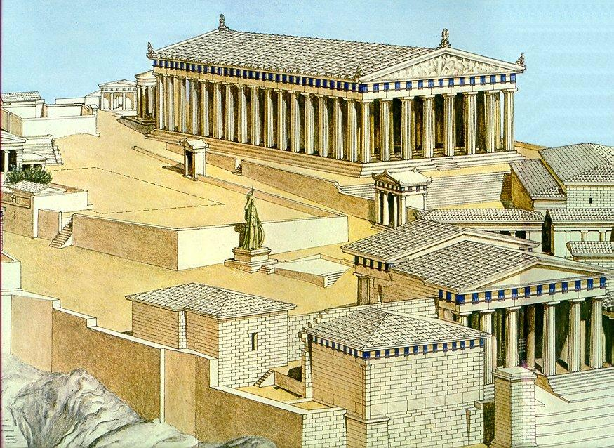
Scale
Architecture may relate to the scale of humans
  If not, architecture may be
    Monumental, impressive
    Intimidating, frightening
  Columns on building can give illusion of scale
  Surroundings and adjacent buildings can scale-up or scale-down a building

Slide 6
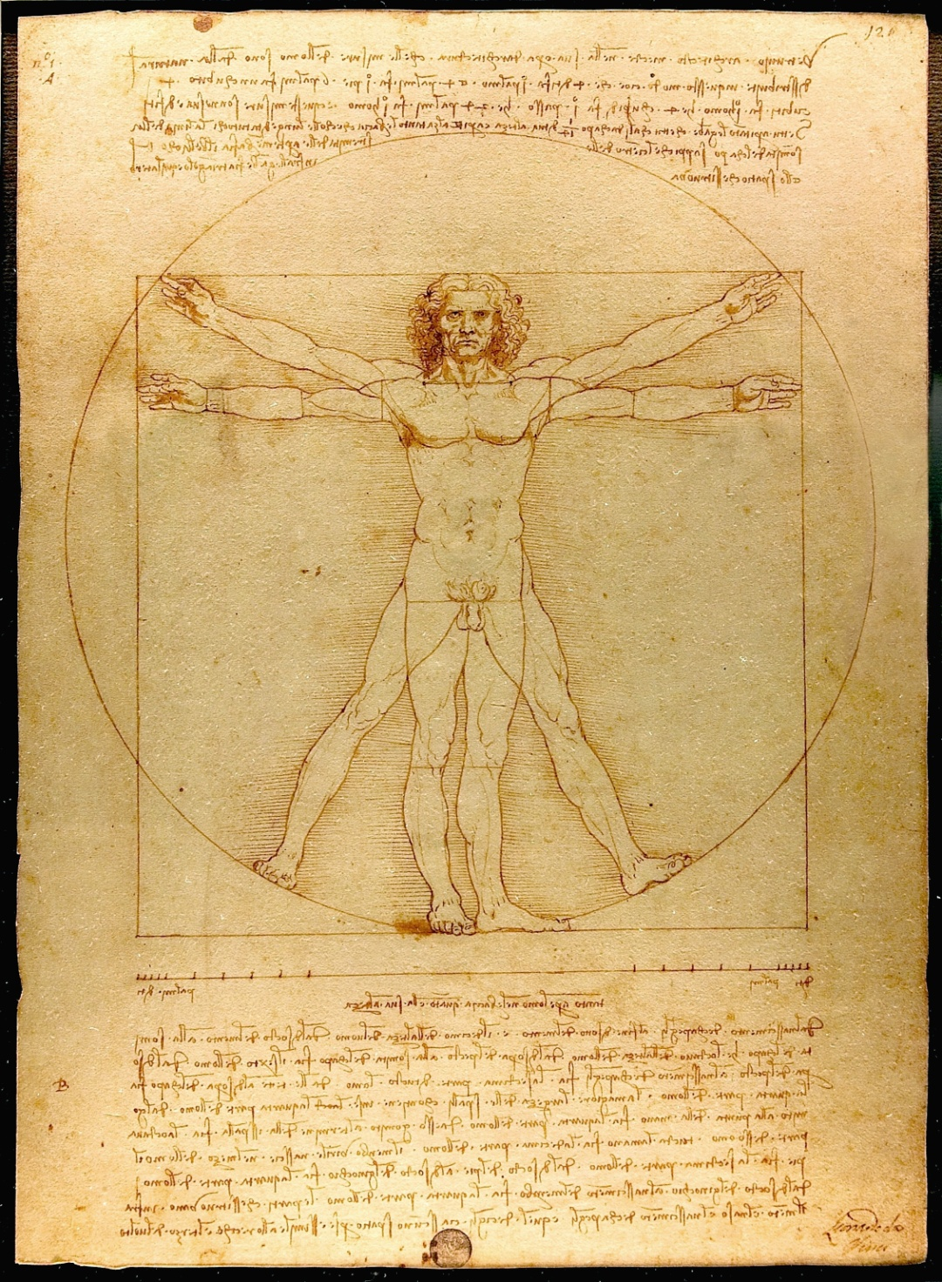
Behavior
Bodies create space
  Activities
    Ergonomics
  Group interactions
  Beliefs
  Movement through spaces
  Flow - interior to exterior
    Bank of widows and French doors invite outside in

Slide 7
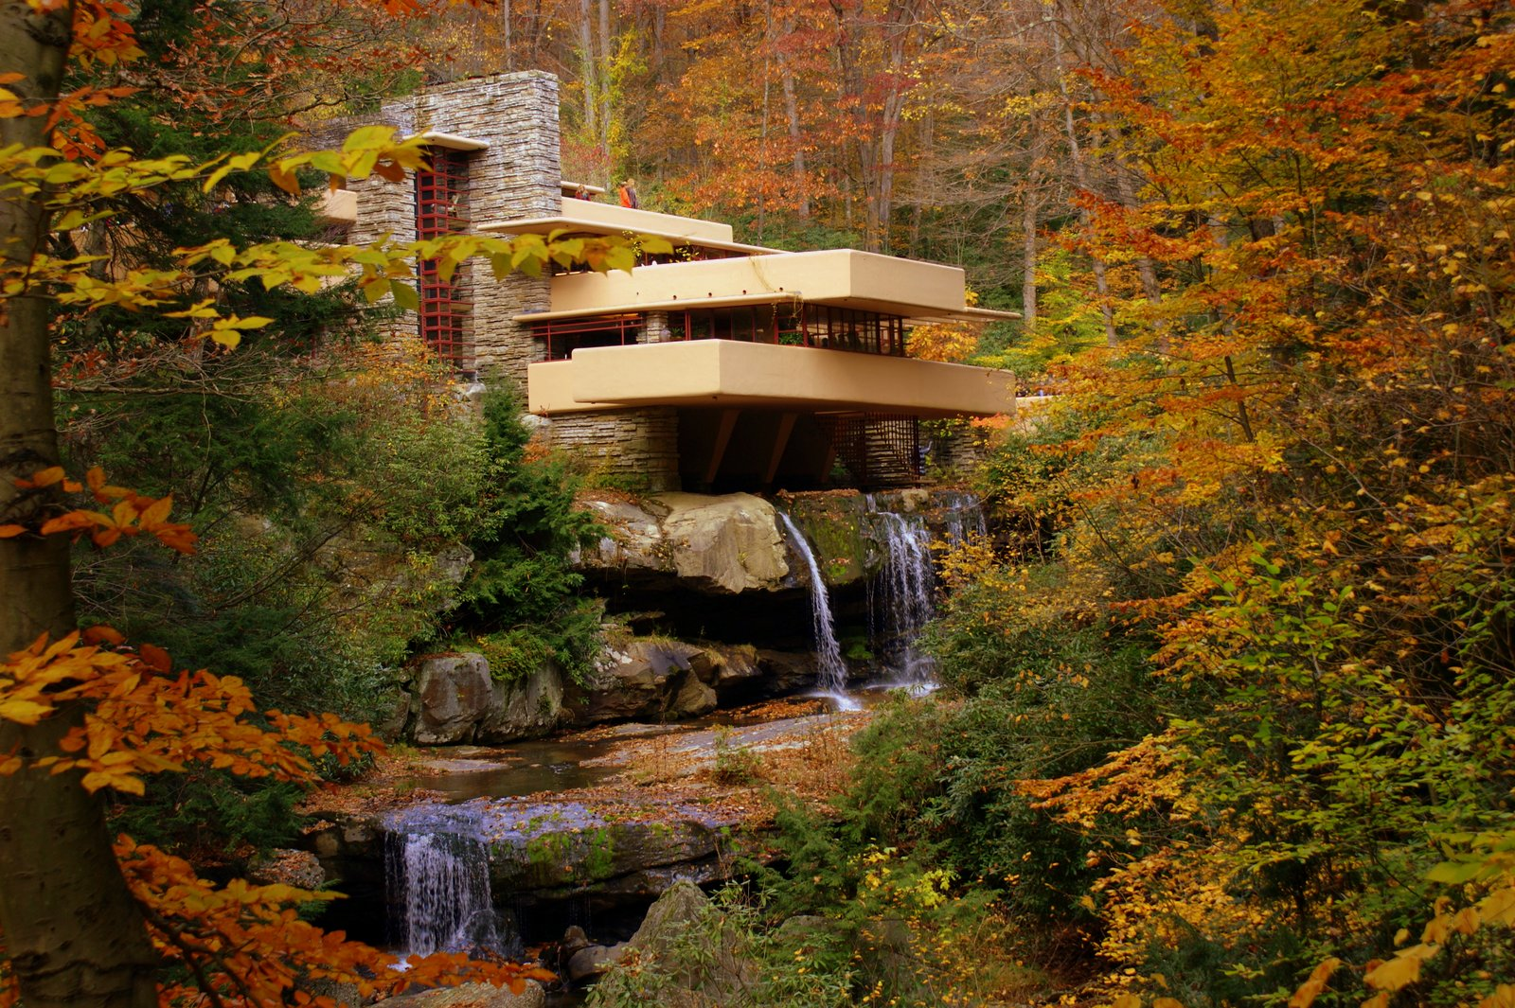
Context
Architecture can be an expression of a time
Can relate to other buildings
Can relate to land
Be “Organic” !
Photograph by other

Slide 8
Photograph by other

Slide 9
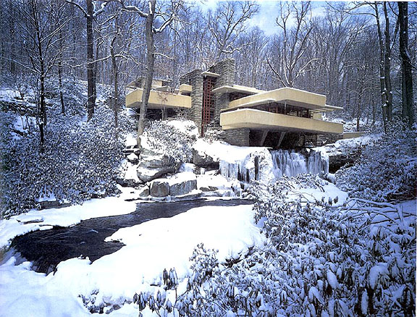
Photograph by other

Slide 10
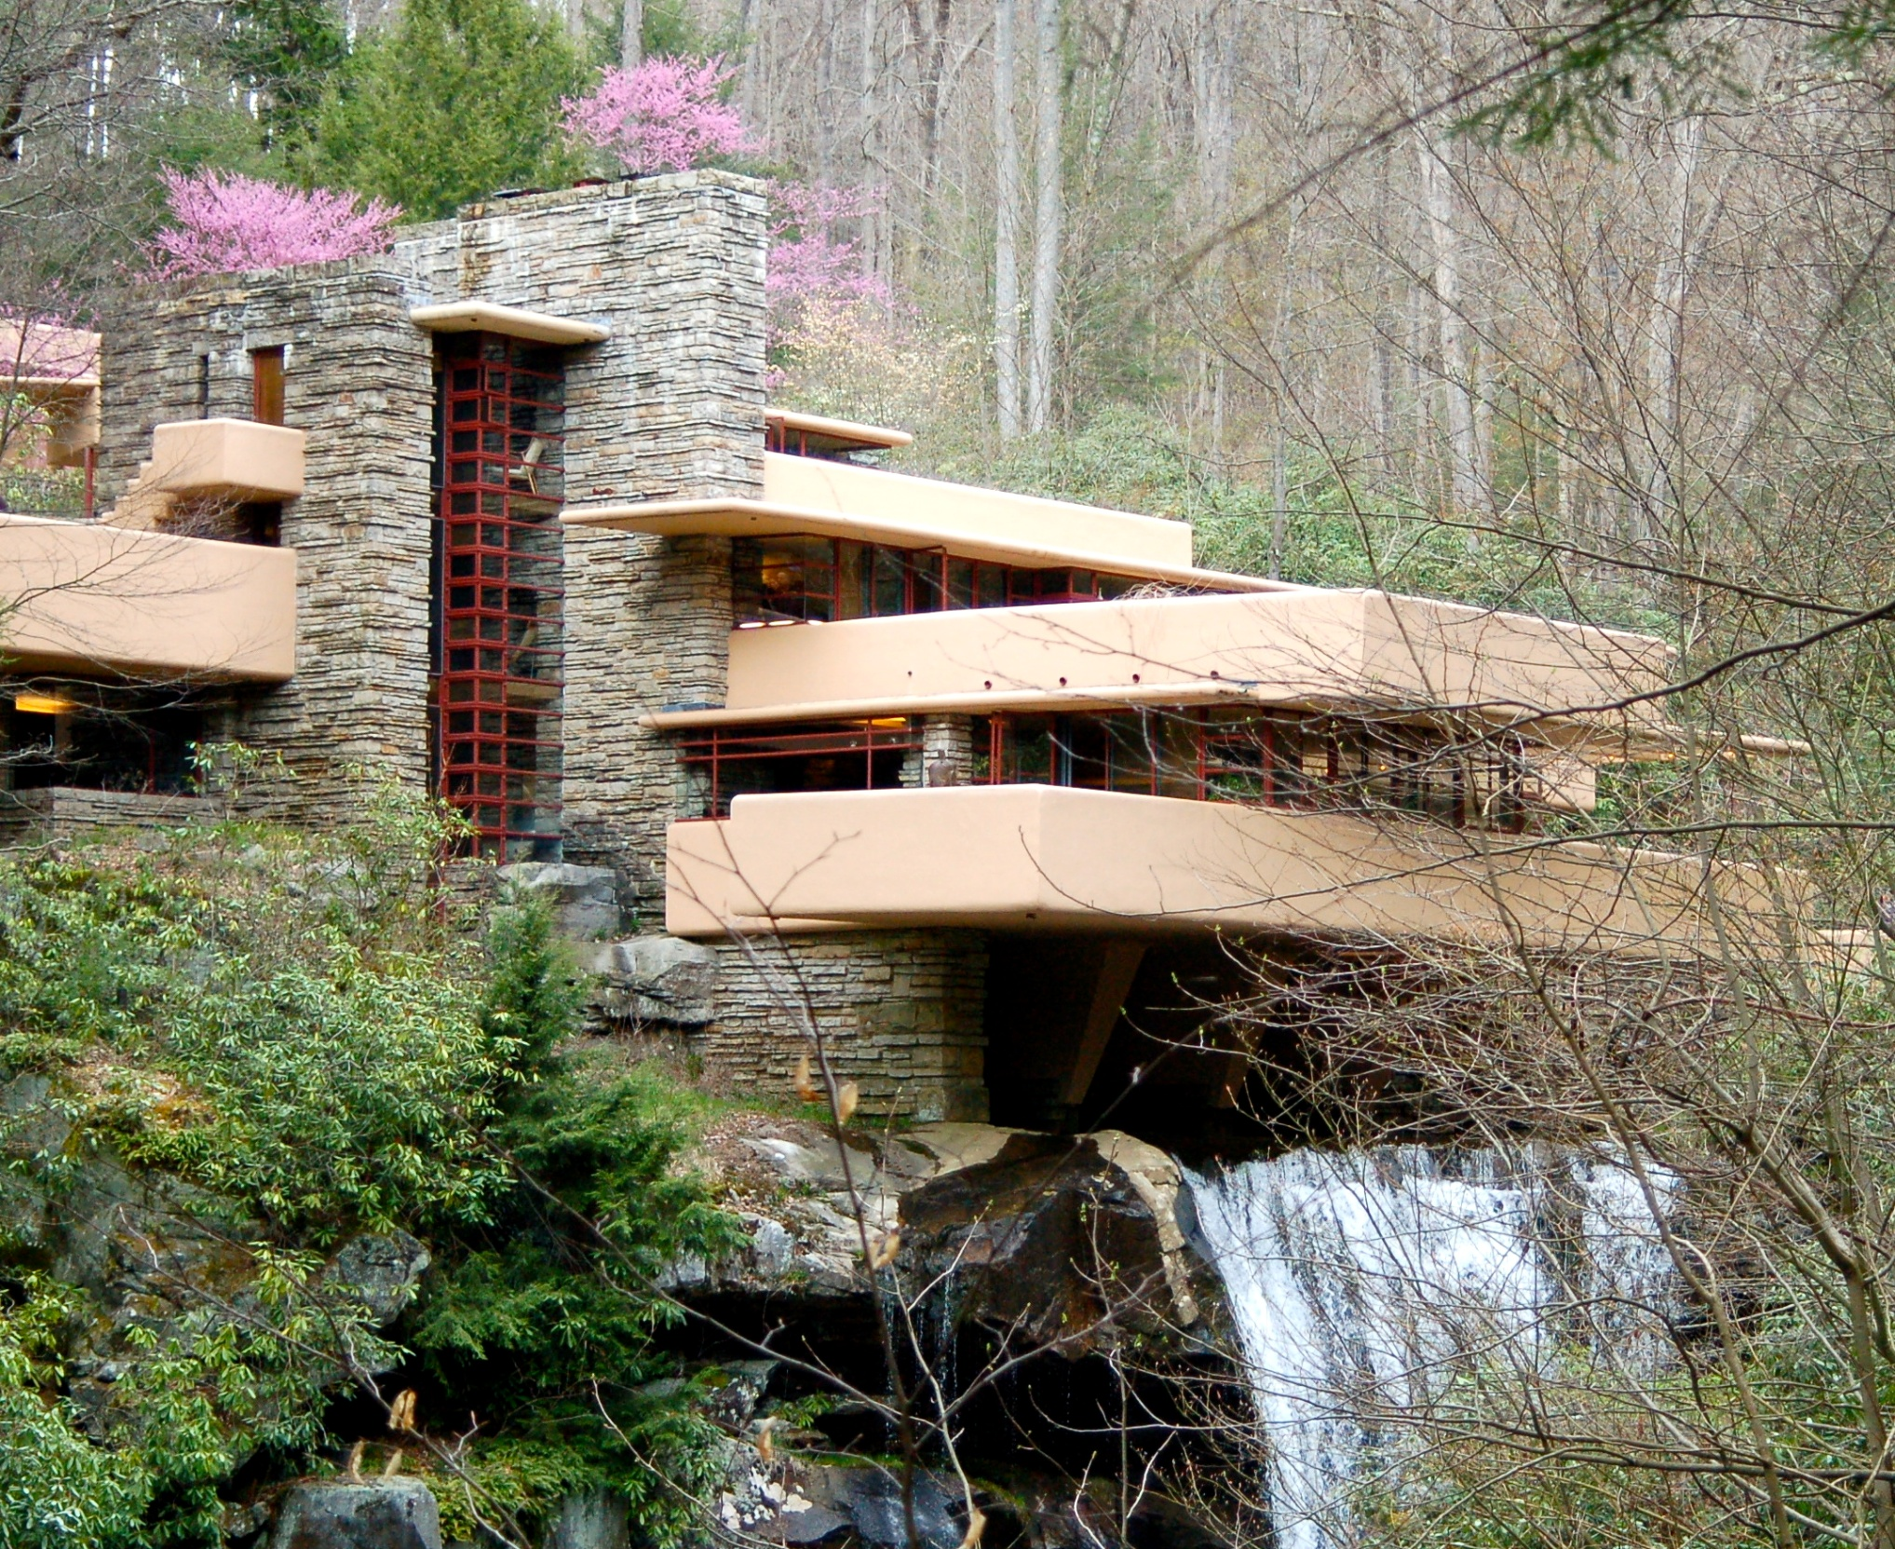
Photograph by other

Slide 11
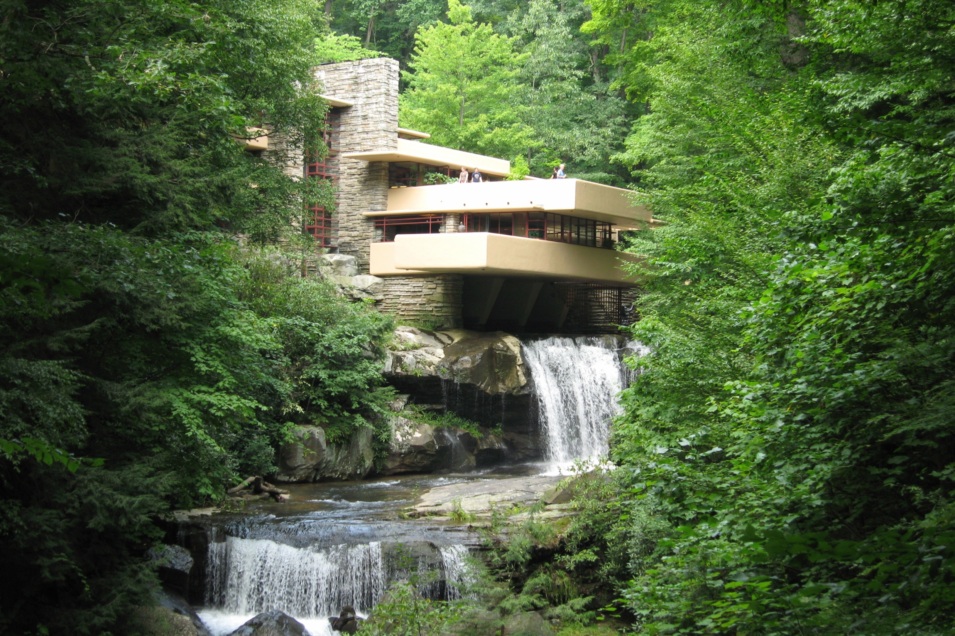
Photograph by other

Slide 12
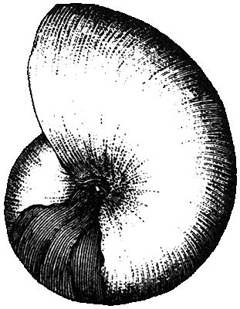
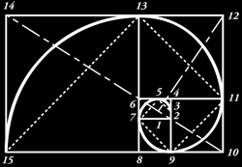
Proportion
Relation between spaces
  Between rooms in a floor plan
  Between elements of a facade

Slide 13
Balance
Symmetry
  May symbolize order, or wealth
  May put people at ease (perceived stable)
Asymmetry
  Can symbolize revolt
  Can evoke feeling of movement & excitement, or comfort
  Can arise from organic vernacular growth
    Medieval cities
  Frank Lloyd Wright made entrances low and dark to surprise you with the final destination
  Also, light at end of corridor draws you in

Slide 14
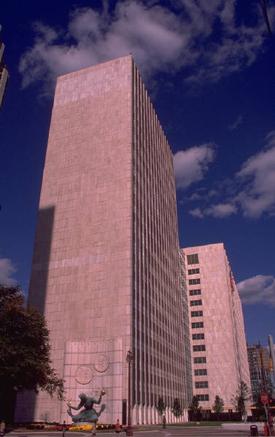
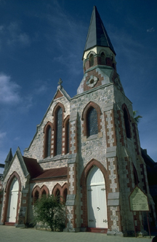
Symbolism
Power
Status
Change
Tradition
Spirit
Photographs by others

Slide 15
Tastes
Change over time
Vary across cultures

Slide 16
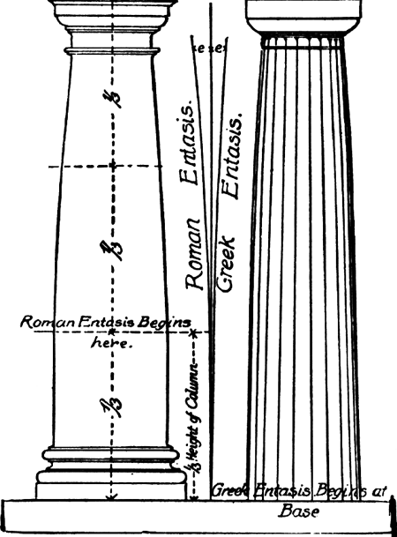
Anthropomorphism
Animate the inanimate
  Equate columns with humans
    “Entasis” in columns is a slight curvature to resemble hips

Slide 17
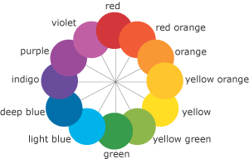
Color
Harmonized colors
  Use different hues of same color
  or pair hues of colors close to
  each other on color wheel

Slide 18
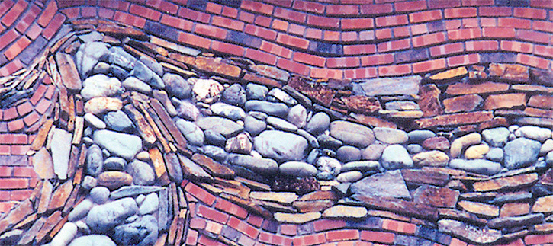
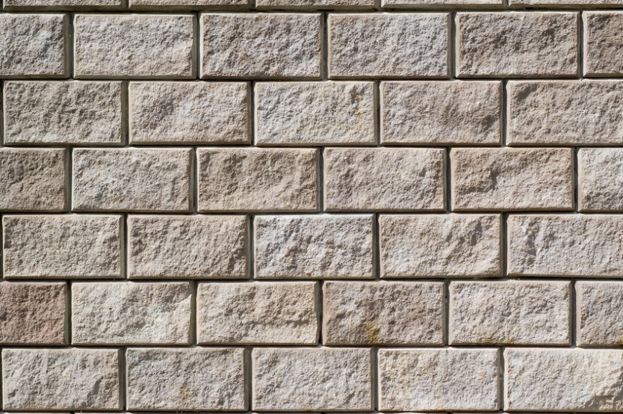
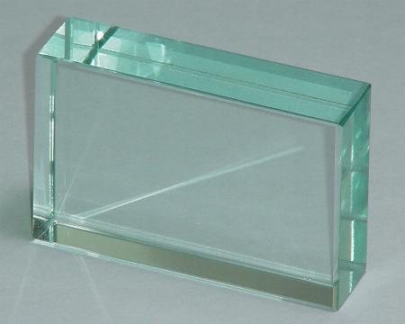
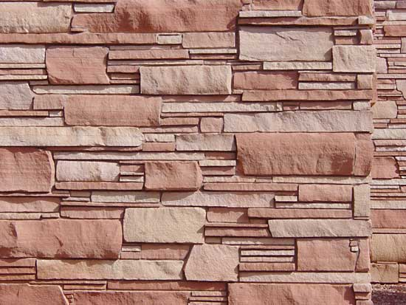
Texture
Random Ordered
Smooth Rough
Photograps by others

Slide 19
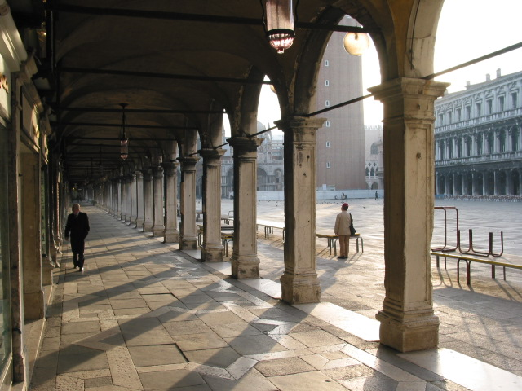
Rhythm
Like Music

Slide 20
Rhythm

Slide 21
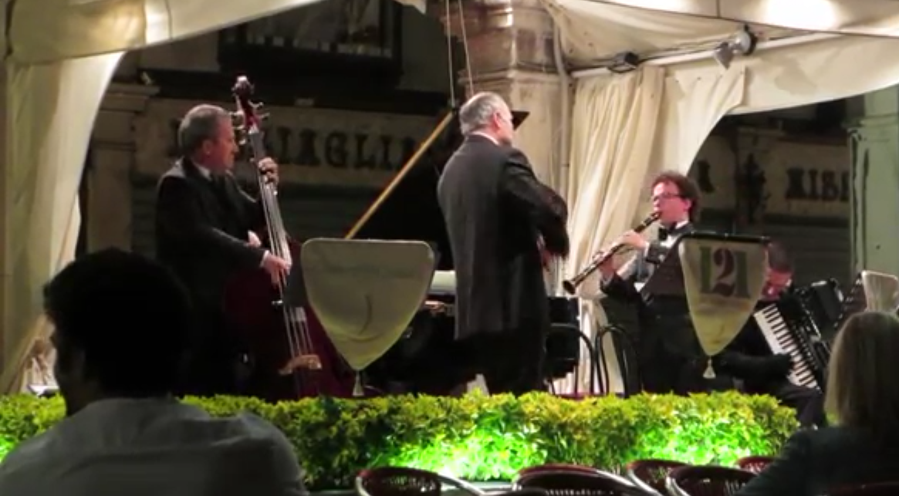
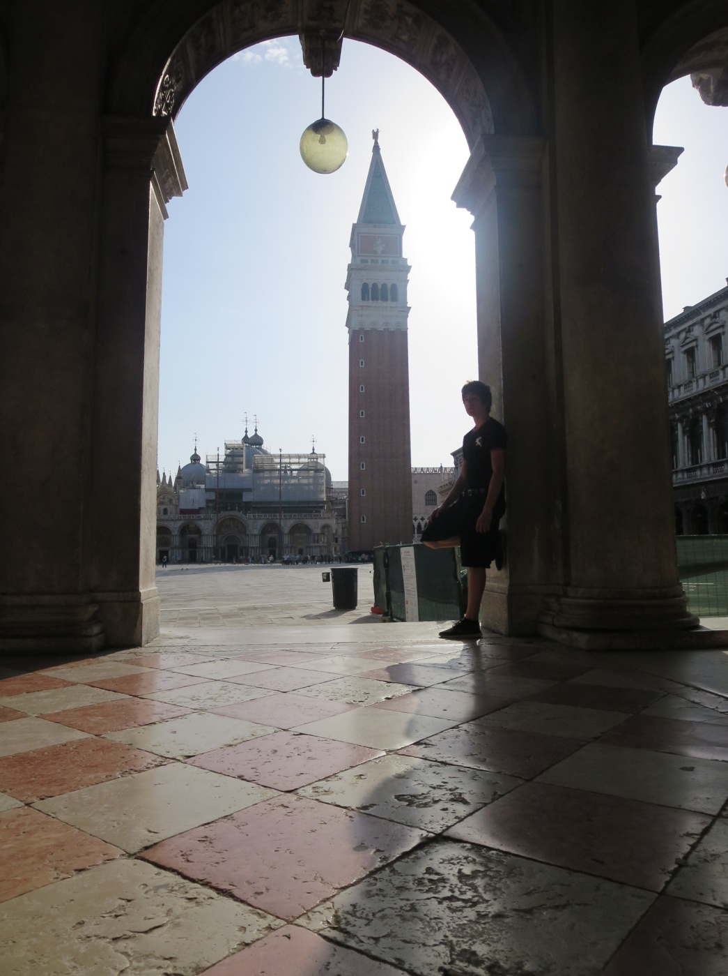
Rhythm
VIDEO: https://www.youtube.com/watch?v=36Fmp2pVKOc

Slide 22
Some J Wunderlich Personal Case Studies

Slide 23
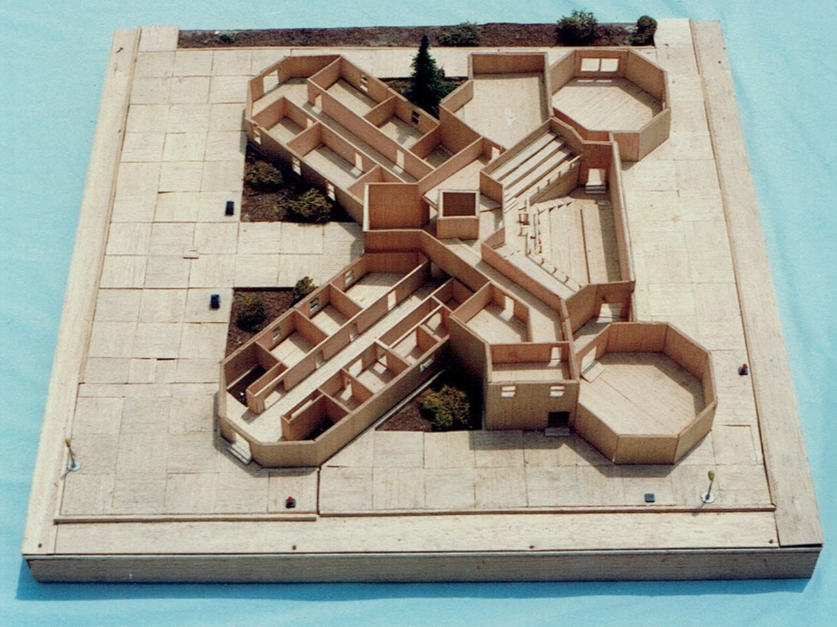
JT Wunderlich 1977 (age 16) high school student
3rd prize
Philadelphia Municipal Building
Pennsylvania state-wide Architectural Design Competition
ARCHITECTURE THEORY (2015 reflection)
Form = interconnected octagons
Scale = human
Behavior = welcoming, serving
Context = metropolitan city center
Proportion = complimenting octagons
Balance = symmetrical
Symbolism = democracy, leadership
Tastes = simple geometric forms
Anthropomorphism = none intended
Color = uniform
Texture = smooth, ordered
Rhythm = radiating center
STYLE = Modern

Slide 24
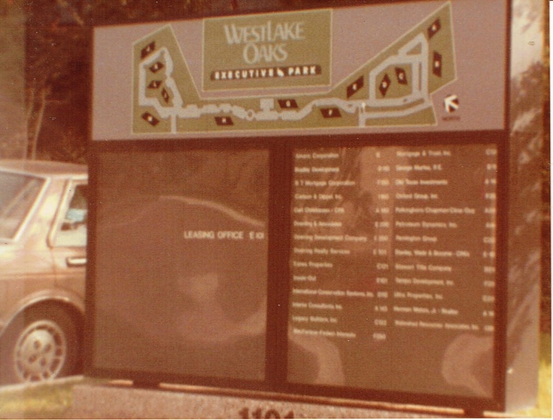
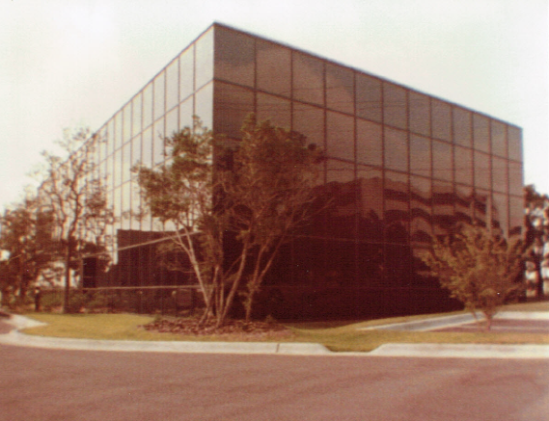
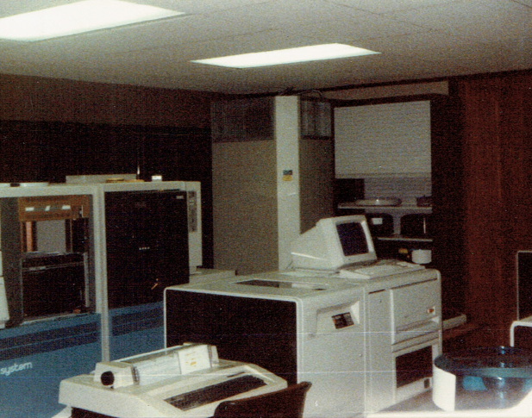
JT Wunderlich 1984,85 “Project Manager” / Designer
Doerring Development Company
Austin TX
Helped Design and Build a thirteen building office park
One of two IBM360 Computer Centers in complex

Slide 25
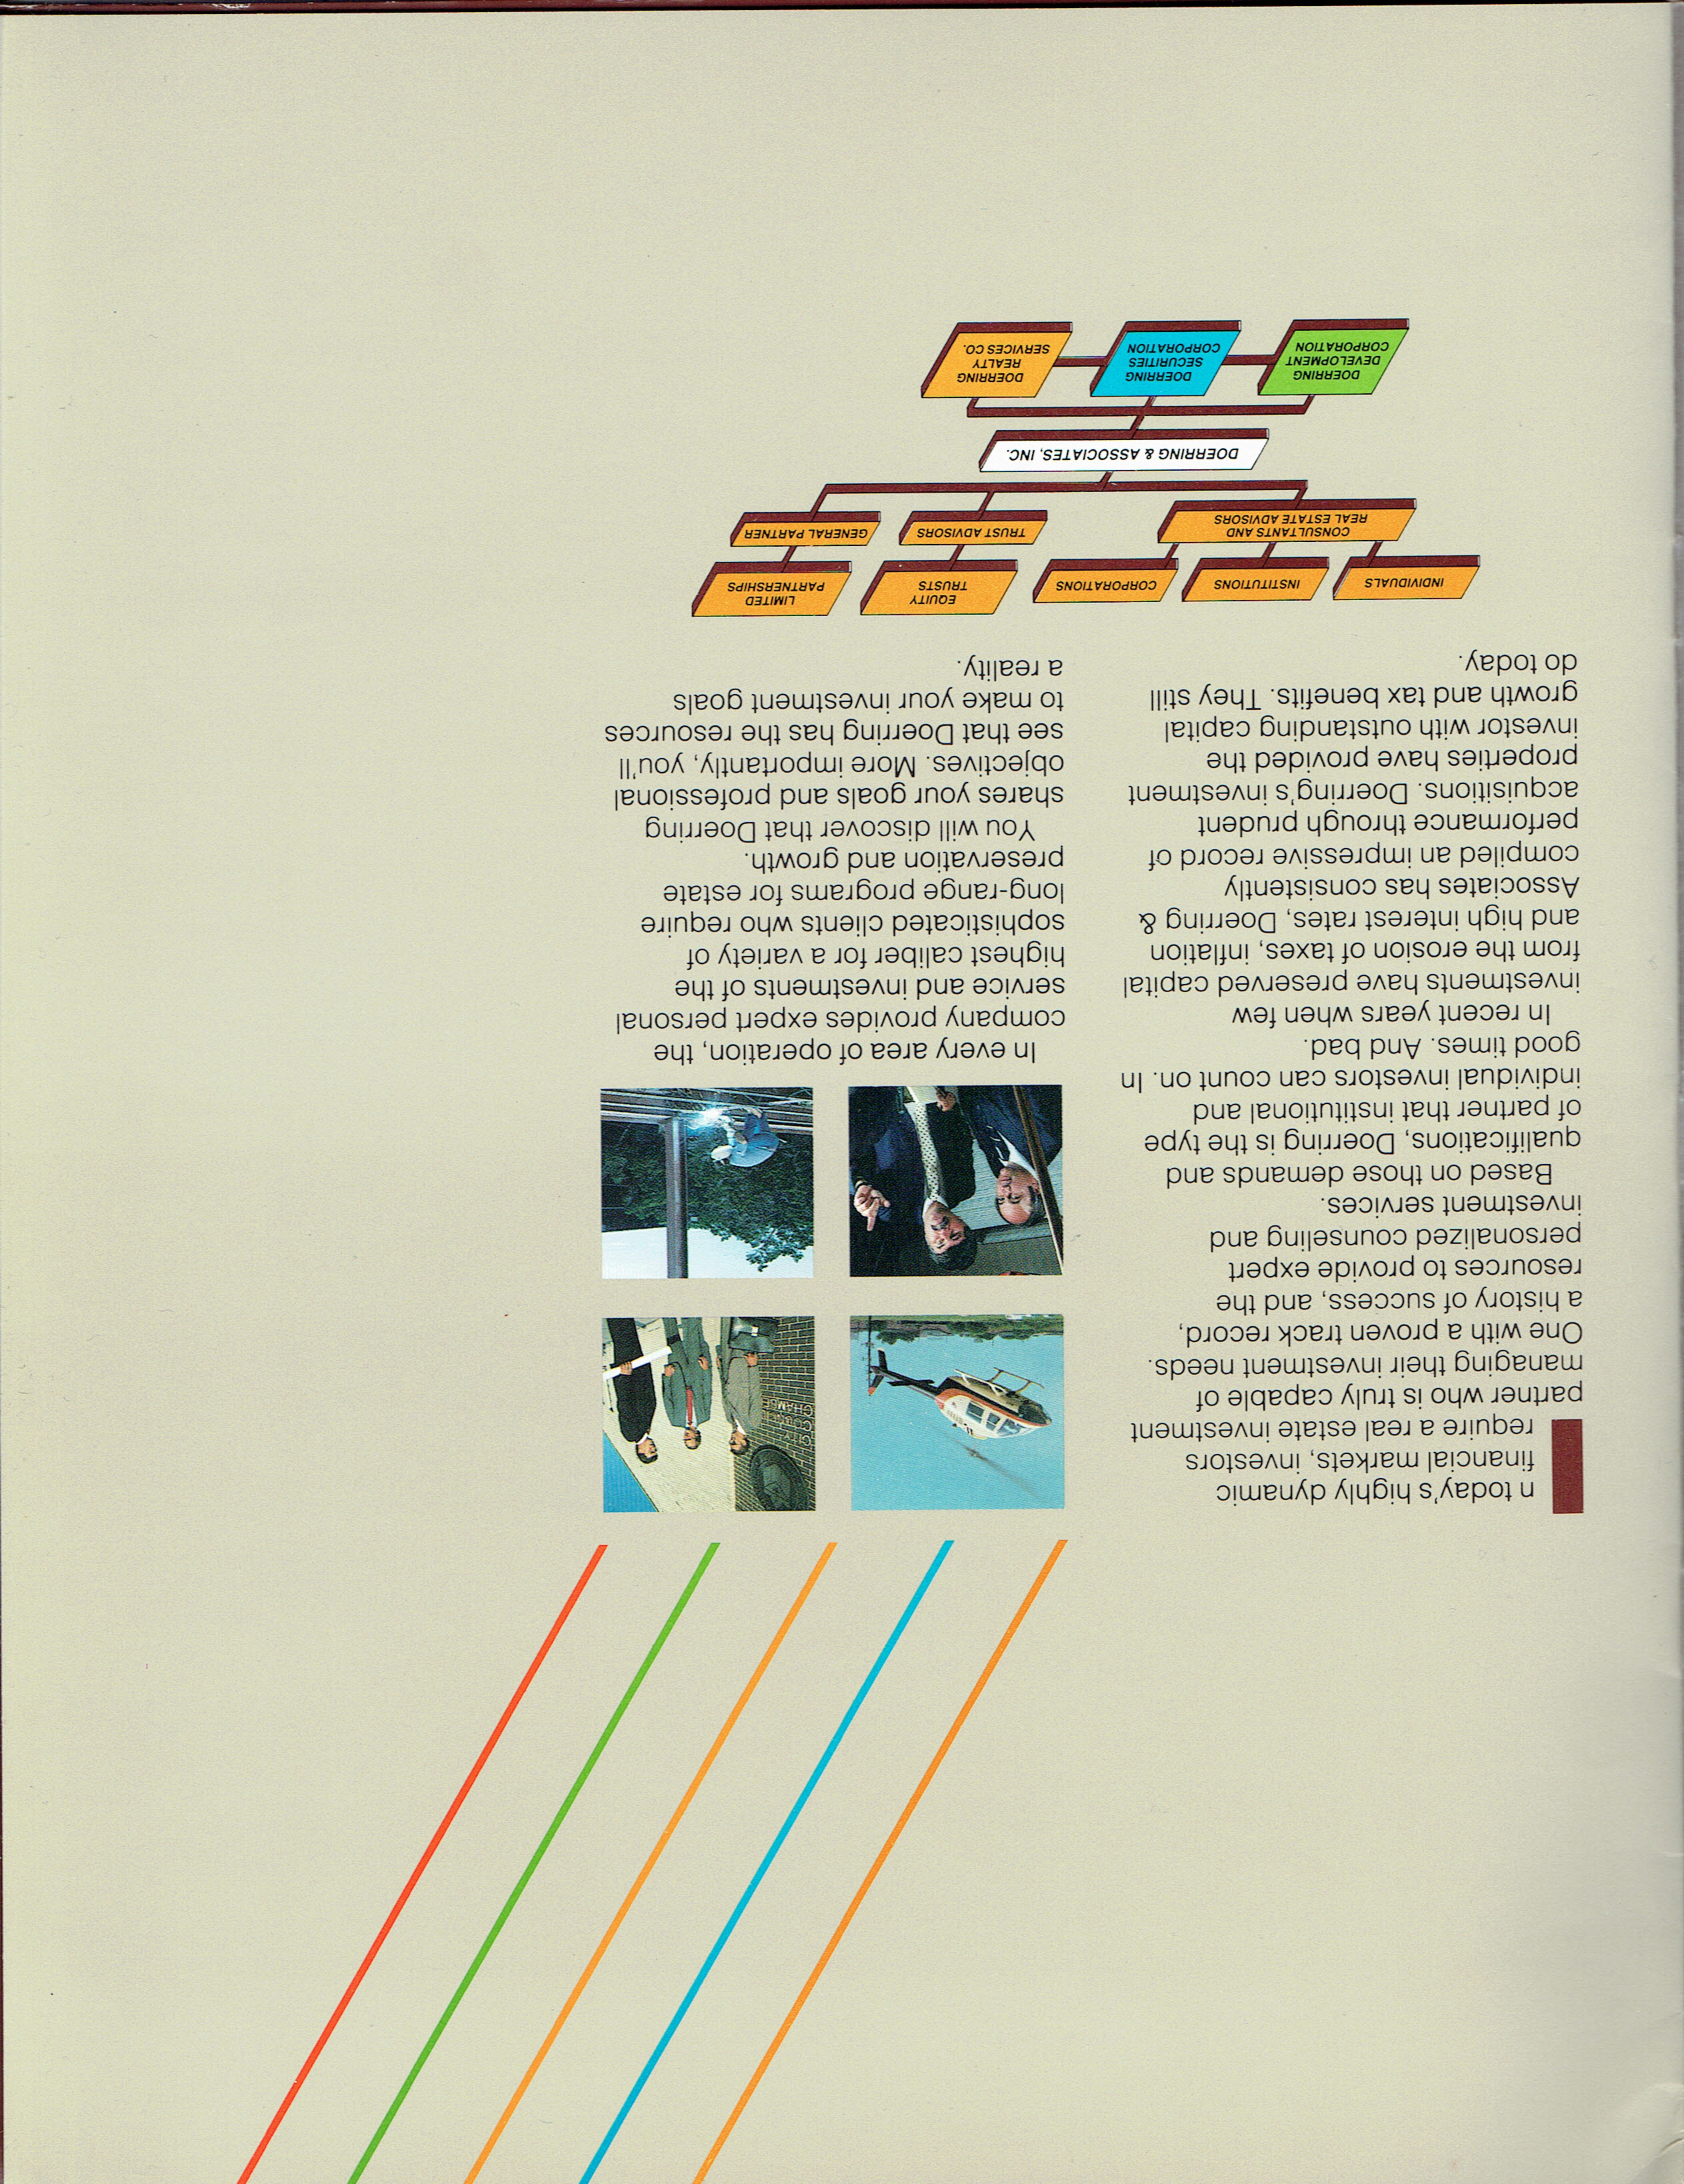
Wrote architectural
and engineering specifications
Worked under
registered Architect at Doerring Development Corporation, one of the companies of Doerring & Associates
Managed all construction (Doerring acted as General Contractor)
JT Wunderlich 1984,85 “Project Manager” / Designer
Doerring Development Company
Austin TX

Slide 26
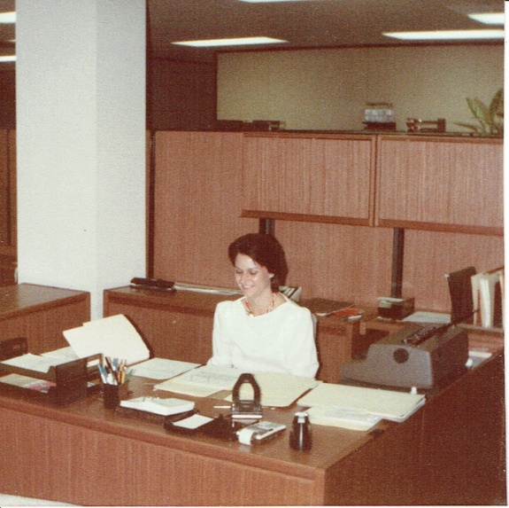
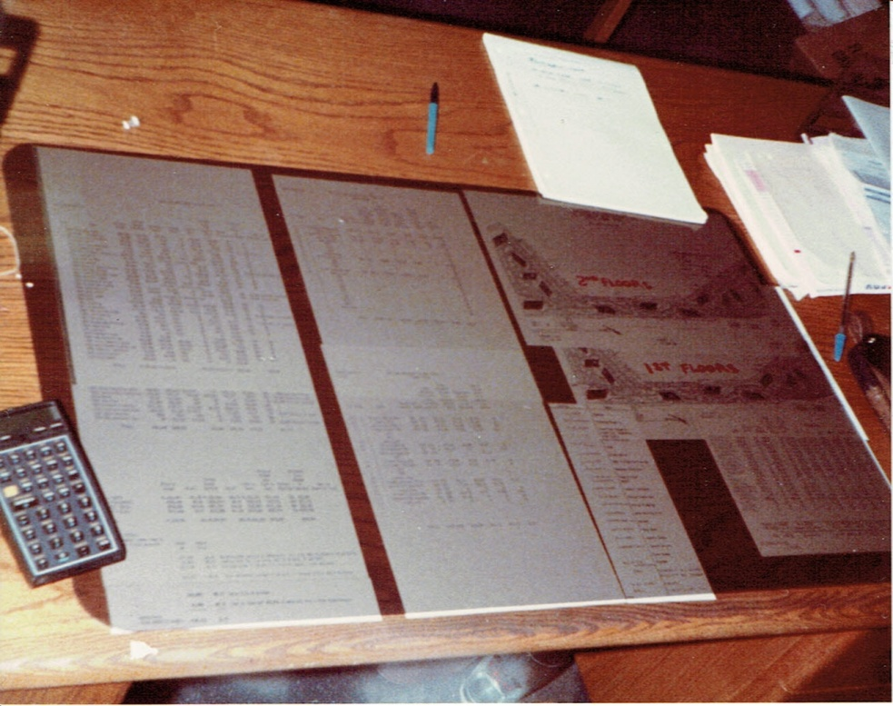
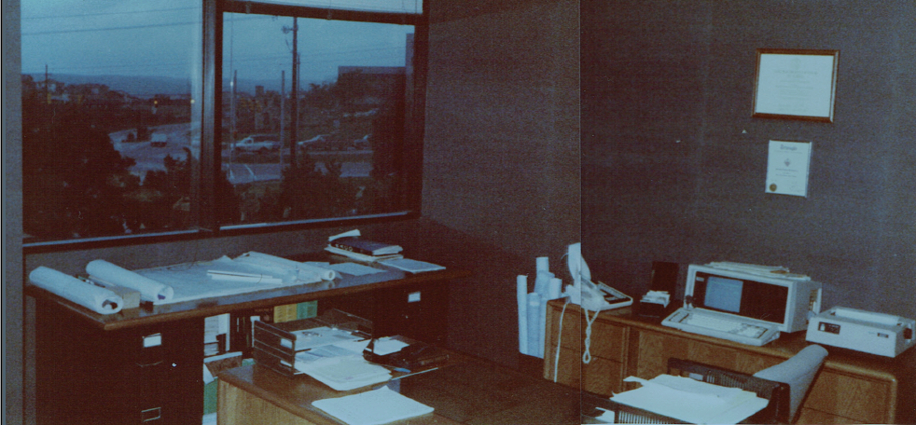
JT Wunderlich 1984,85 “Project Manager” / Designer
Doerring Development Company
Austin TX
My office

Slide 27

JT Wunderlich 1984,85 “Project Manager” / Designer
Doerring Development Company
Austin TX
ARCHITECTURE THEORY (2015 reflection)
Form = sharp-edged cubes
Scale = monumental cluster
Behavior = private work spaces
Context = minimal imposition on landscape
Proportion = parallelogram-buildings; complimenting each other
Balance = asymmetrical
Symbolism = changing, but complimenting, the natural landscape
Tastes = simplicity
Anthropomorphism = none
Color = reflective black (camouflage)
Texture = smooth, ordered
Rhythm = melodic site plan
STYLE = Modern

Slide 28
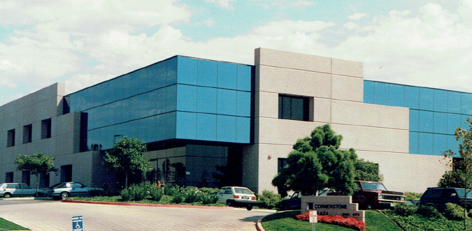
High-tech office complex in San Diego CA
JDC inc (Development Company), La Jolla CA
  On Architectural Design Team
  (as Developer’s Representative – “Director of Projects” )
  Added significant Architectural Design
  Project nominated for annual San Diego “Orchid Award”
JT Wunderlich 1985,86 “Director of Projects” / Designer

Slide 29
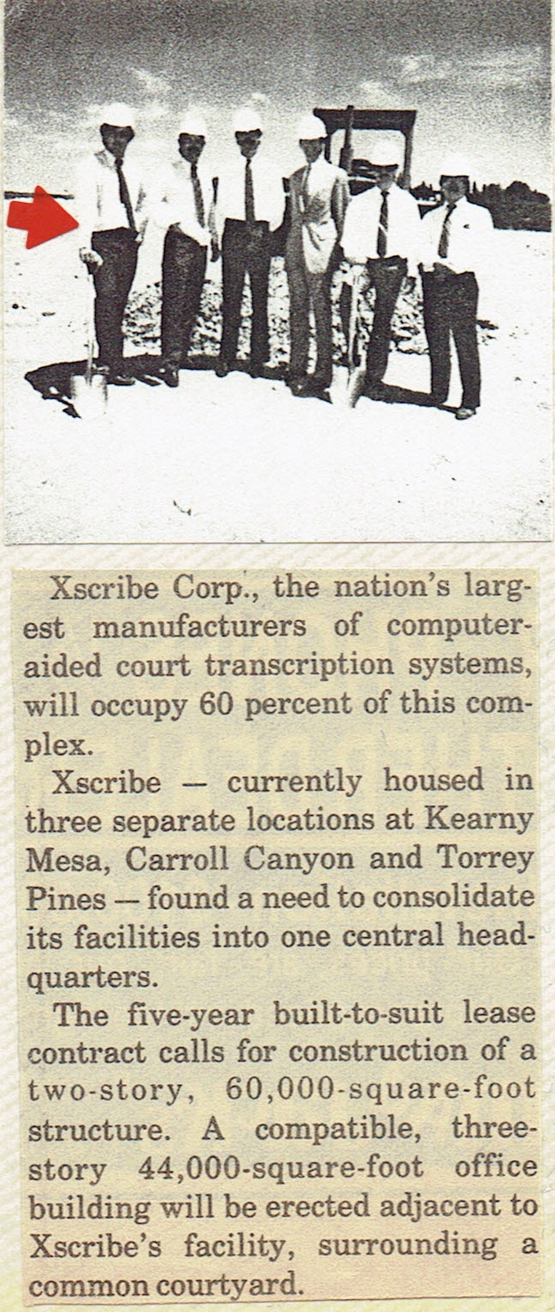
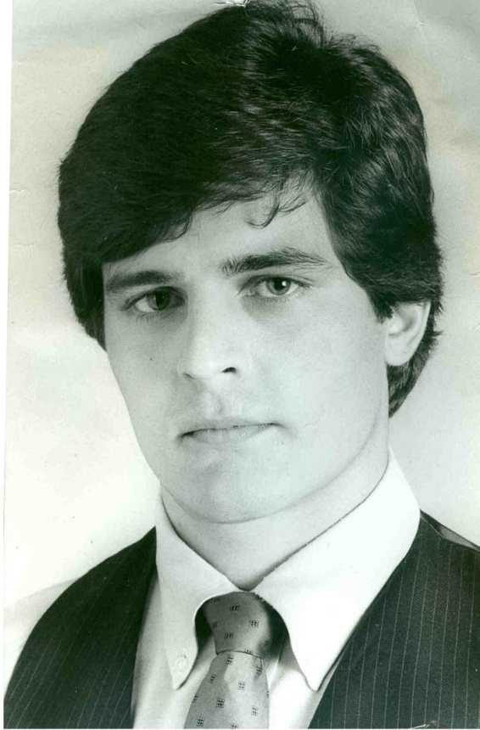
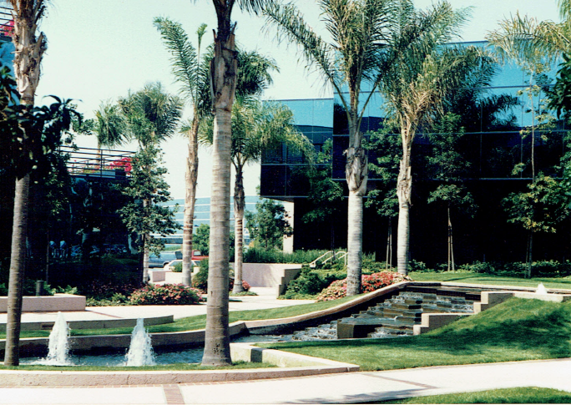
JT Wunderlich 1985,86 “Director of Projects” / Designer
La Jolla, CA

Slide 30
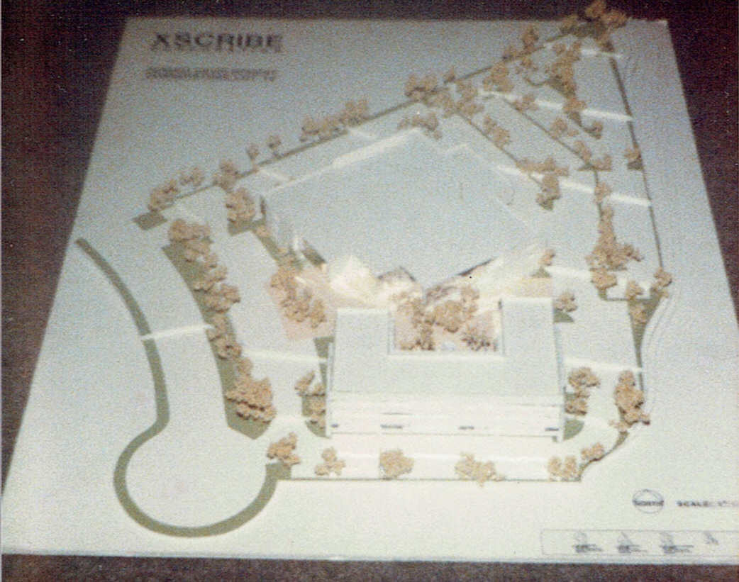
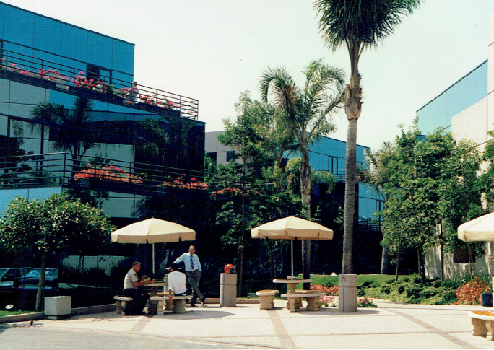
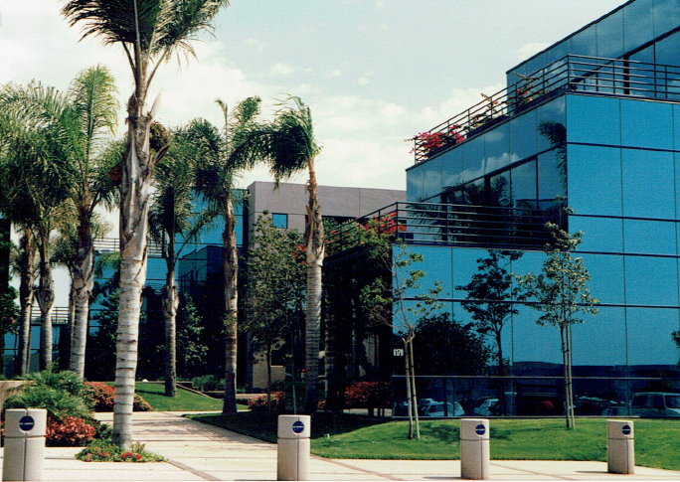
JT Wunderlich 1985,86 “Director of Projects” / Designer
La Jolla, CA
66,000sf hi-tech office
and light manufacturing
44,00sf office building

Slide 31
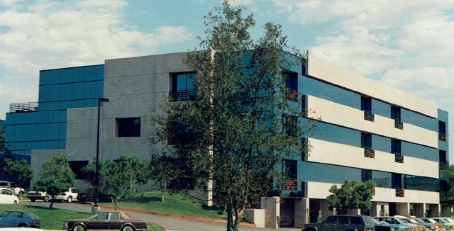
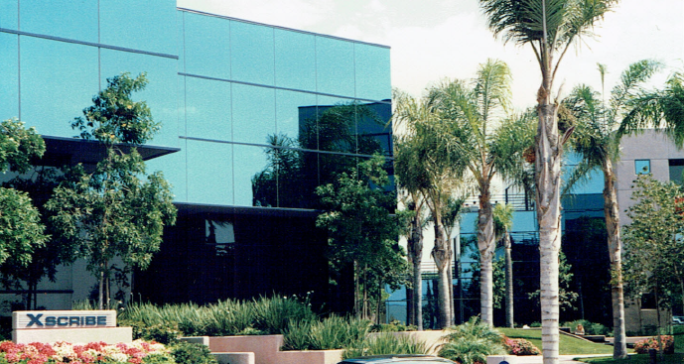
JT Wunderlich 1985,86 “Director of Projects” / Designer
La Jolla, CA

Slide 32
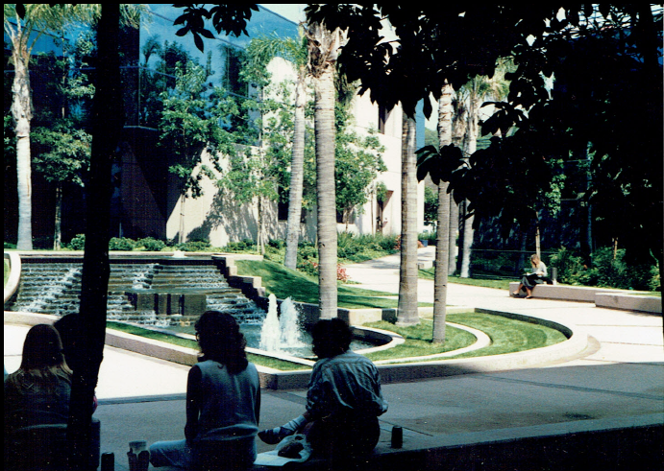
JT Wunderlich 1985,86 “Director of Projects” / Designer
La Jolla, CA

Slide 33
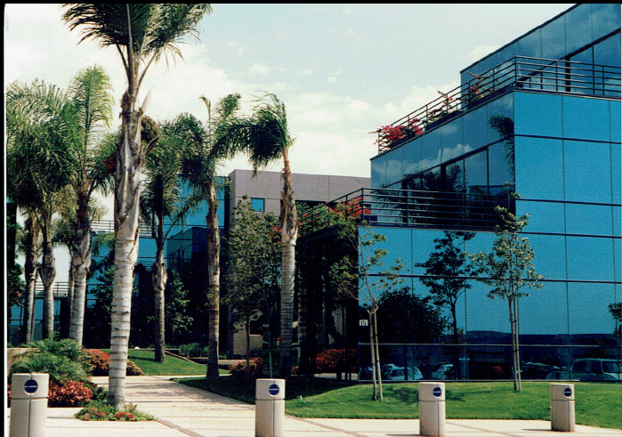
High-tech office complex in San Diego CA
JDC inc (Development Company), La Jolla CA
JT Wunderlich 1985,86 “Director of Projects” / Designer
ARCHITECTURE THEORY (2015 reflection)
Form = sharp-edged cubes
Scale = both human & monumental
Behavior = outgoing, but peaceful within
Context = San Diego high tech
Proportion = blue cube in pink shell
Balance = asymmetrical
Symbolism = change, birth, tech
Tastes = cubic with soft connections
Anthropomorphism = emergence
Color = pastel pink, blue, green
Texture = smooth, ordered
Rhythm = harmonized
STYLE = Modern

Slide 34
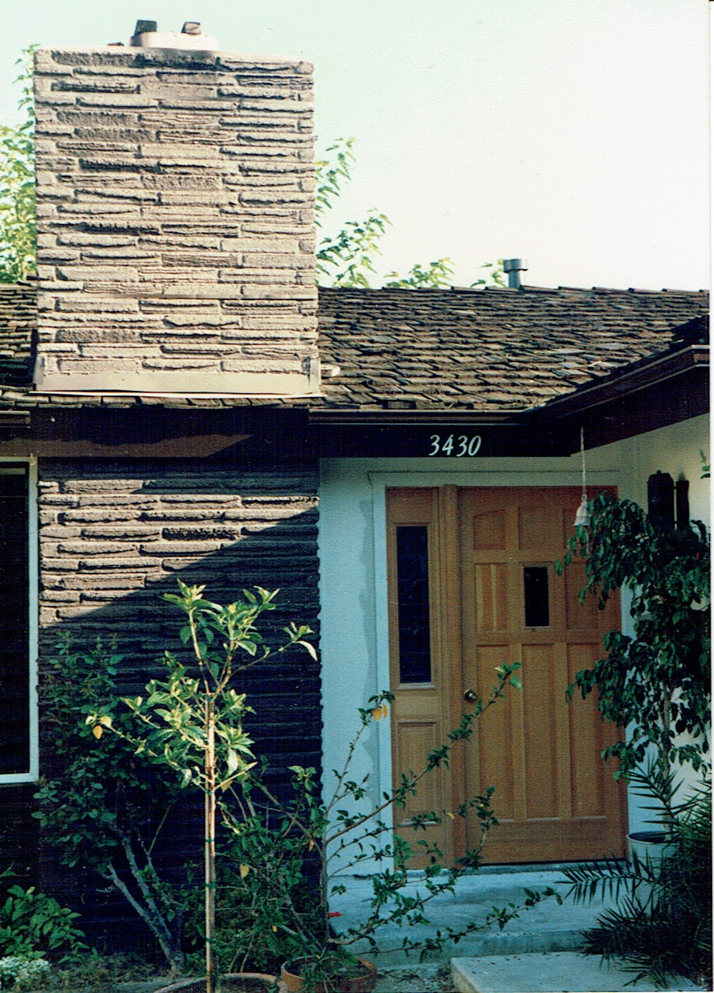
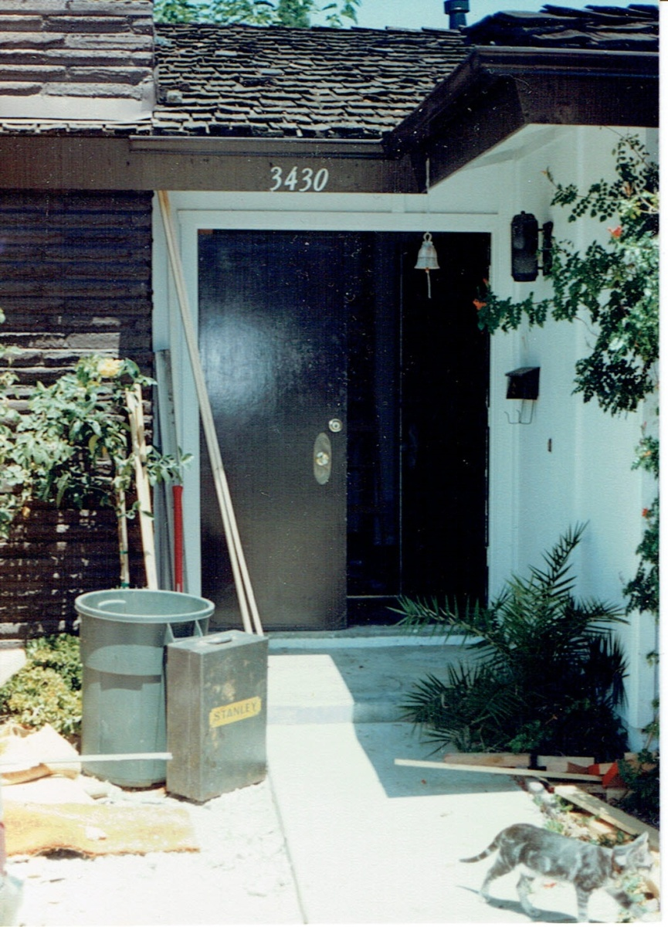
1000sf Calivita Remodel
San Diego, CA
JT Wunderlich 1987 Design/Builder
Before After

Slide 35
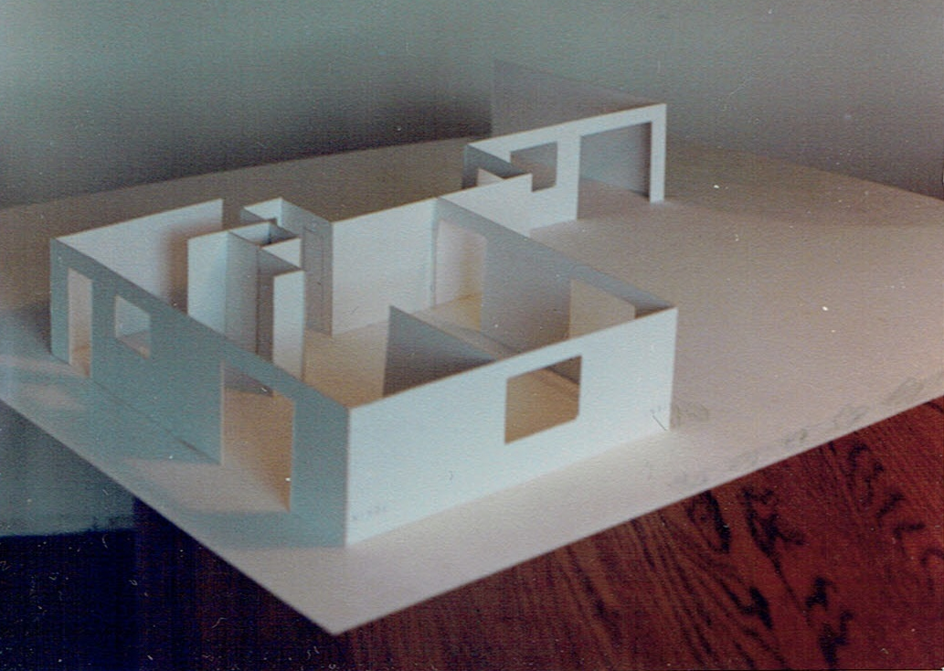
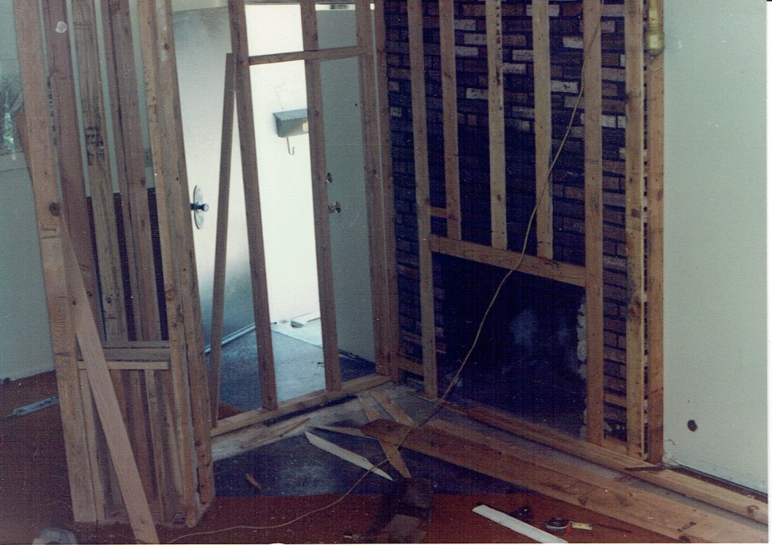
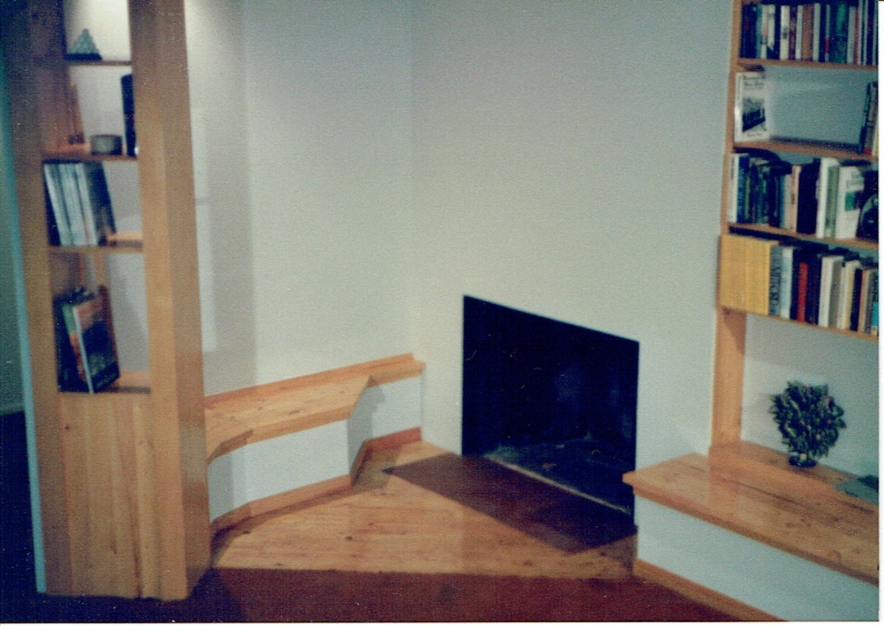
JT Wunderlich 1987 Design/Builder
San Diego, CA

Slide 36
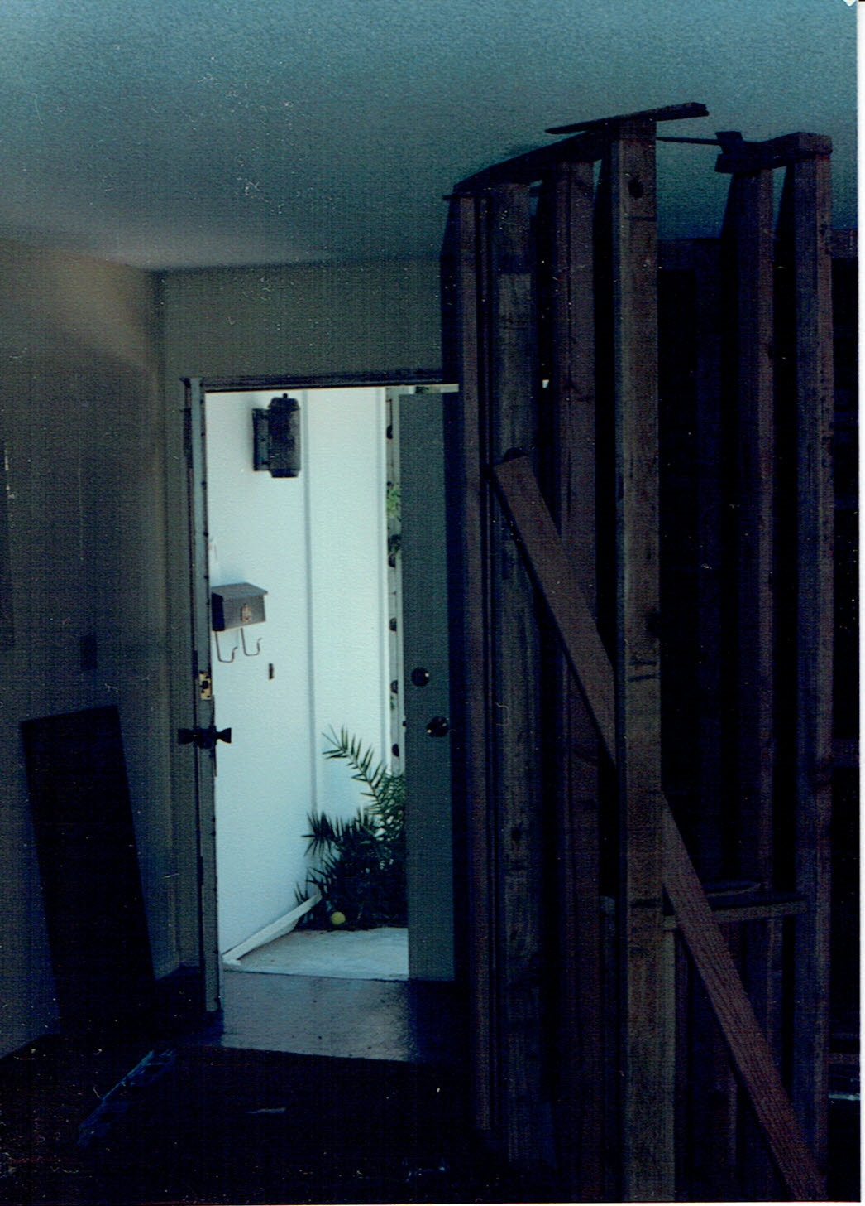
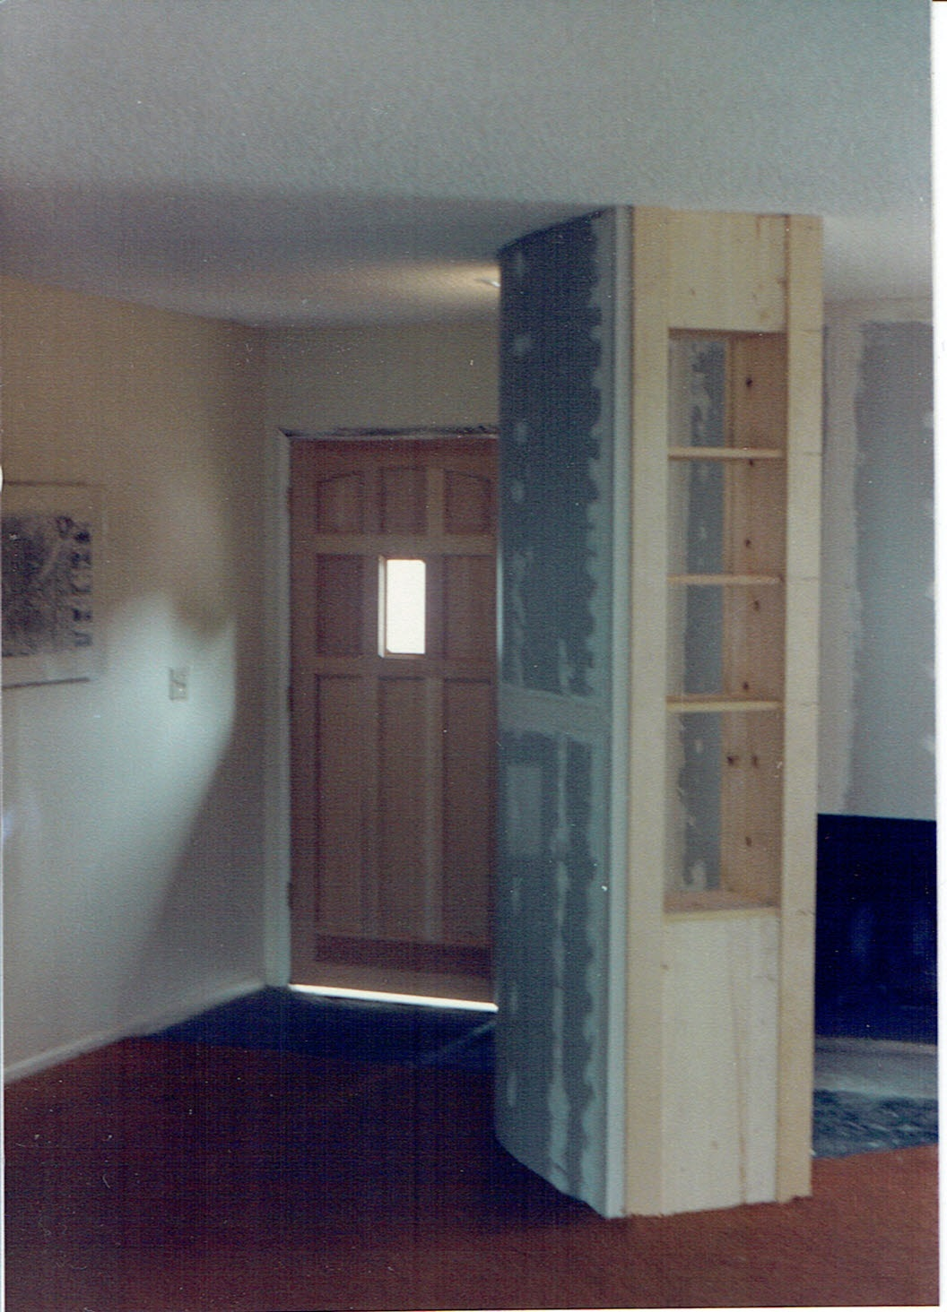
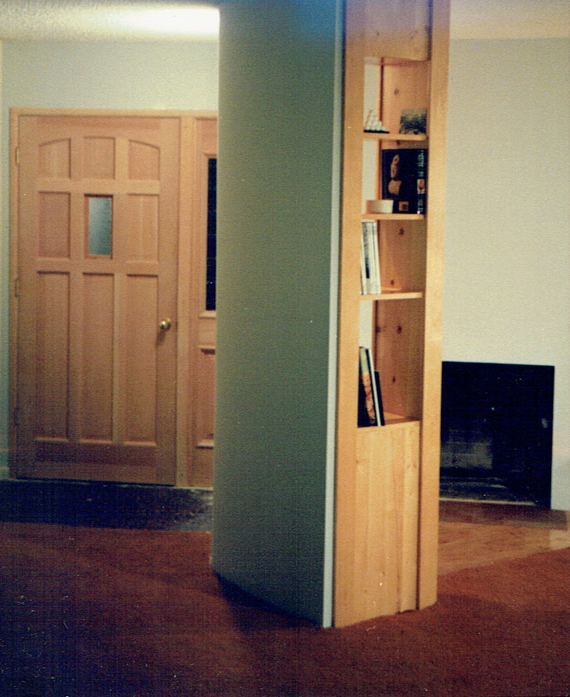
JT Wunderlich 1987 Design/Builder
San Diego, CA

Slide 37
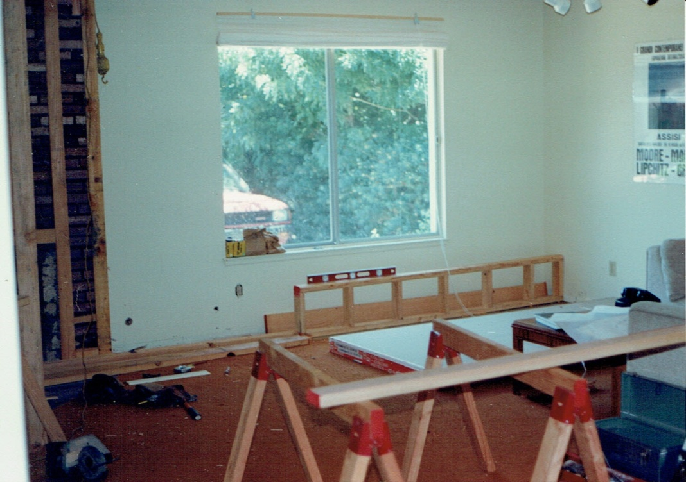
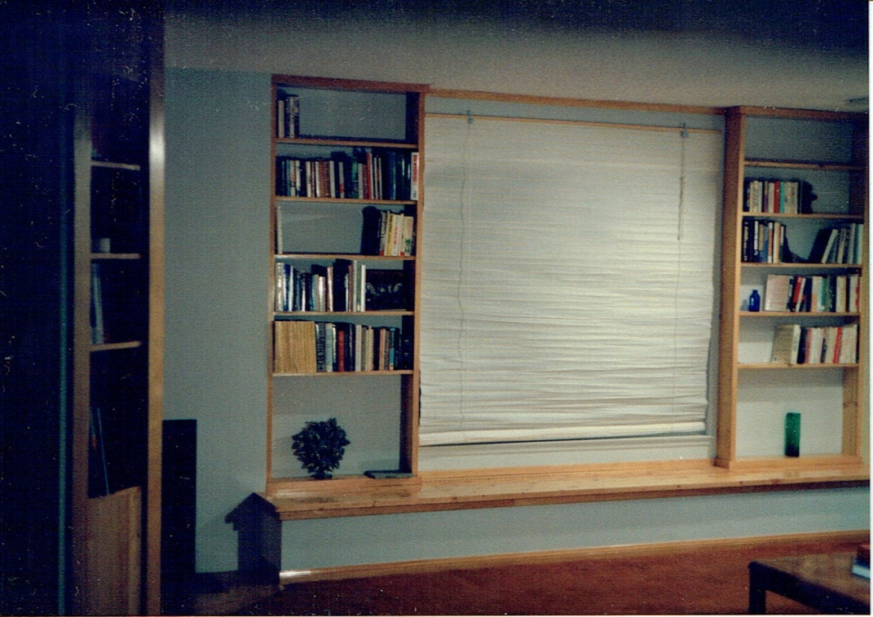

JT Wunderlich 1987 Design/Builder
San Diego, CA
Also work in kitchen and bedrooms - No pictures taken

Slide 38
1000sf Calivita Remodel
San Diego, CA
JT Wunderlich 1987 Design/Builder
ARCHITECTURE THEORY (2015 reflection)
Form = rectilinear & Euclidean
Scale = human
Behavior = nesting
Context = San Diego
Proportion = paired rectangles
Balance = asymmetrical
Symbolism = tasteful upgrade
Tastes = craftsmen, international
Anthropomorphism = none
Color = complimentary
Texture = varied
Rhythm = syncopated
STYLE = Post-modern, craftsmen

Slide 39

JT Wunderlich 1989,90 Design/Builder
Wayne PA

Slide 40

JT Wunderlich 1989,90 Design/Builder

Slide 41

JT Wunderlich 1989,90 Design/Builder

Slide 42


JT Wunderlich 1989,90 Design/Builder
Wayne PA

Slide 43



JT Wunderlich 1989,90 Design/Builder
Wayne PA

Slide 44

JT Wunderlich 1989,90 Design/Builder
Wayne PA

Slide 45


JT Wunderlich 1989,90 Design/Builder
Wayne PA
Also, other work in bathrooms, throughout house, and landscape.
- No photo’s taken

Slide 46


JT Wunderlich 1989,90 Design/Builder
School Lane Remodel
Wayne PA
ARCHITECTURE THEORY (2015 reflection)
Form = gables, vertical
Scale = human
Behavior = home
Context = suburb
Proportion = vertical
Balance = symmetrical
Symbolism = raise the roof
Tastes = traditional
Anthropomorphism = none
Color = pastels, natural wood
Texture = smooth, ordered
Rhythm = slow tempo
STYLE = Colonial, Post-modern

Slide 47

A Pennsylvania Country Home Design

Slide 48

A Pennsylvania Country Home Design
Inspired by childhood on Philadelphia Main Line
And trips to Europe

Slide 49

A Pennsylvania Country Home Design
Site

Slide 50




THREE MAJOR DESIGN CHOICES

Slide 51



selected design
DESIGN CHOICE 3

Slide 52


A Pennsylvania Country Home Design
Reminds me of this picture I took in St. Peters Cathedral in the Vatican in Rome after I had built this -→

Slide 53

A Pennsylvania Country Home Design
Before and After

Slide 54

JT Wunderlich 2002 Homeowner / Design-Builder
Southeastern Pennsylvania
2000sf remodel +1500sf new
4000 man hours
Only contract was shingles and concrete mix truck
No Employees

Slide 55
JT Wunderlich 2002-present Homeowner / Design-Builder
Southeastern Pennsylvania
2000sf remodel +1500sf new
ARCHITECTURE THEORY (2015 reflection)
Form = cubes and gables, vertical
Scale = human
Behavior = home, animal reserve
Context = Amish and Mennonite farmland
Proportion = complimentary gables
Balance = asymmetrical
Symbolism = stability, family, framed vista’s
Tastes = traditional, simple elegance
Anthropomorphism = none intended
Color = white, grey, black
Texture = smooth, ordered
Rhythm = semi-syncopated
STYLE = Post-modern, colonial, craftsmen

